Slide 1







Patient Triage & Appointment System
Team members: Yuyun Yang, Jingwei He

Slide 2
Patient Triage & Appointment System
Y
Background
Goals
The healthcare industry faces increasing administrative workload and staffing shortages, especially in clinics with high patient volume.
To address these challenges, we designed a clean, lightweight backend system that streamlines clinical operations, including:
Secure patient data management
Appointment scheduling support
A backend system developed for dental clinics, enabling DOCTOR, PATIENT, and ADMIN roles to manage appointments with proper access.
Key Highlights:
Built with Spring Boot + PostgreSQL + Docker
Implements RBAC (Role-Based Access Control)
Provides full Create / Read / Update / Delete (CRUD) operations for appointments
Designed with a clean API structure and scalable layered architecture

Slide 3
C
Role-based Access Control & CRUD
Function / Role | Doctor (manage own appointments only) | Patient (manage own appointments only) | Admin (All permissions)
Create appointment | *Check time conflict with the doctor’s own schedule | *Check doctor’s availability *Check time conflict with the patient’s own schedule | Full access
Read appointment | *View all appointments involving the doctor *patient profile(full) | *View own appointments *View only basic doctor profile (firstname, last name, specialty) | Full access
Update appointment | *Modify appointments belonging to the doctor | *Modify own appointments | Full access
Delete appointment | *Delete own appointments | *Delete own appointments | Full access

Slide 4


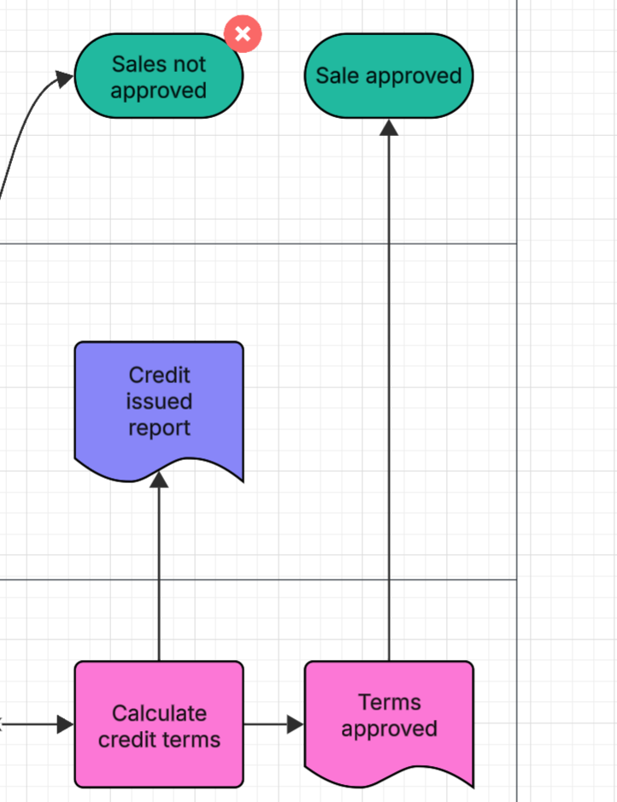

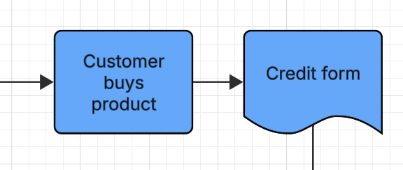

Architecture Overview
Patient Triage & Appointment System
Y
send Http Requests
Frontend / client
Controller
(API gateway)
○ AppointmentController
○ UserController
Receives HTTP requests
DTO
(API contract)
○ AppointmentRequest / Response
○ UserLoginRequest / UserRegisterRequest
○ UserProfile
Prevent entity exposure
Service
(Business logic)
○ AppointmentService
○ UserService
Role-based authorization
Appointment conflict check
Entity
(Data model)
○ Appointment
Docker-compose
(Container)
○ User / UserRole
○ DoctorProfile / AdminProfile / PatientProfile
Persistent domain objects
Repository
(Data access)
○ AppointmentRepository
○ UserRepository
CRUD via JPA
Database
（Data storage）

Slide 5
C
Key OOD Concepts Applied
We encapsulated domain logic within entities and services. Entities keep fields private, and services expose controlled operations.
Encapsulation
User roles share common fields in the User structure and extend with role-specific attributes through relational modeling.
Inheritance
Abstraction
We define interfaces to specify behaviors while hiding the underlying implementation details.
Polymorphism
Service methods behave differently based on user roles.
Single responsibility: each class should have a single purpose
Open/Close: New rules or user roles can be added by extending components without modifying existing logic.
SOLID

Slide 6
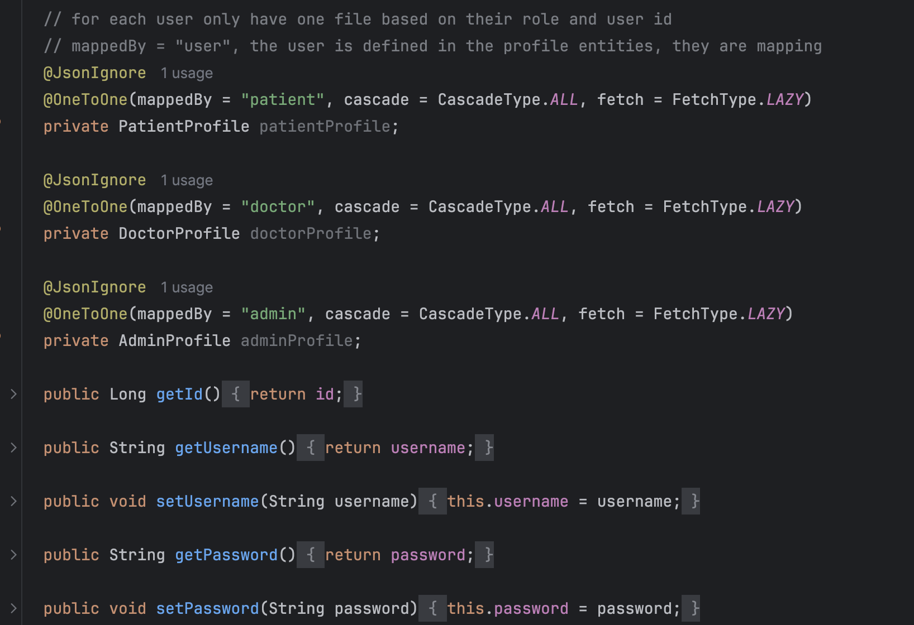
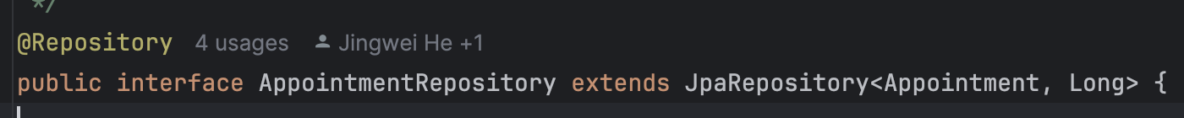
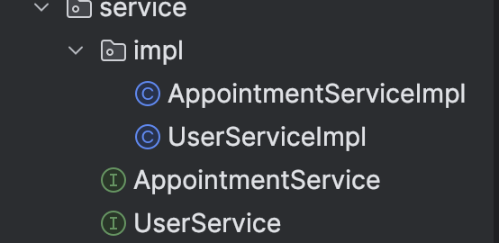
Key OOD Concepts Examples
Encapsulation
Inheritance
Abstraction

Slide 7
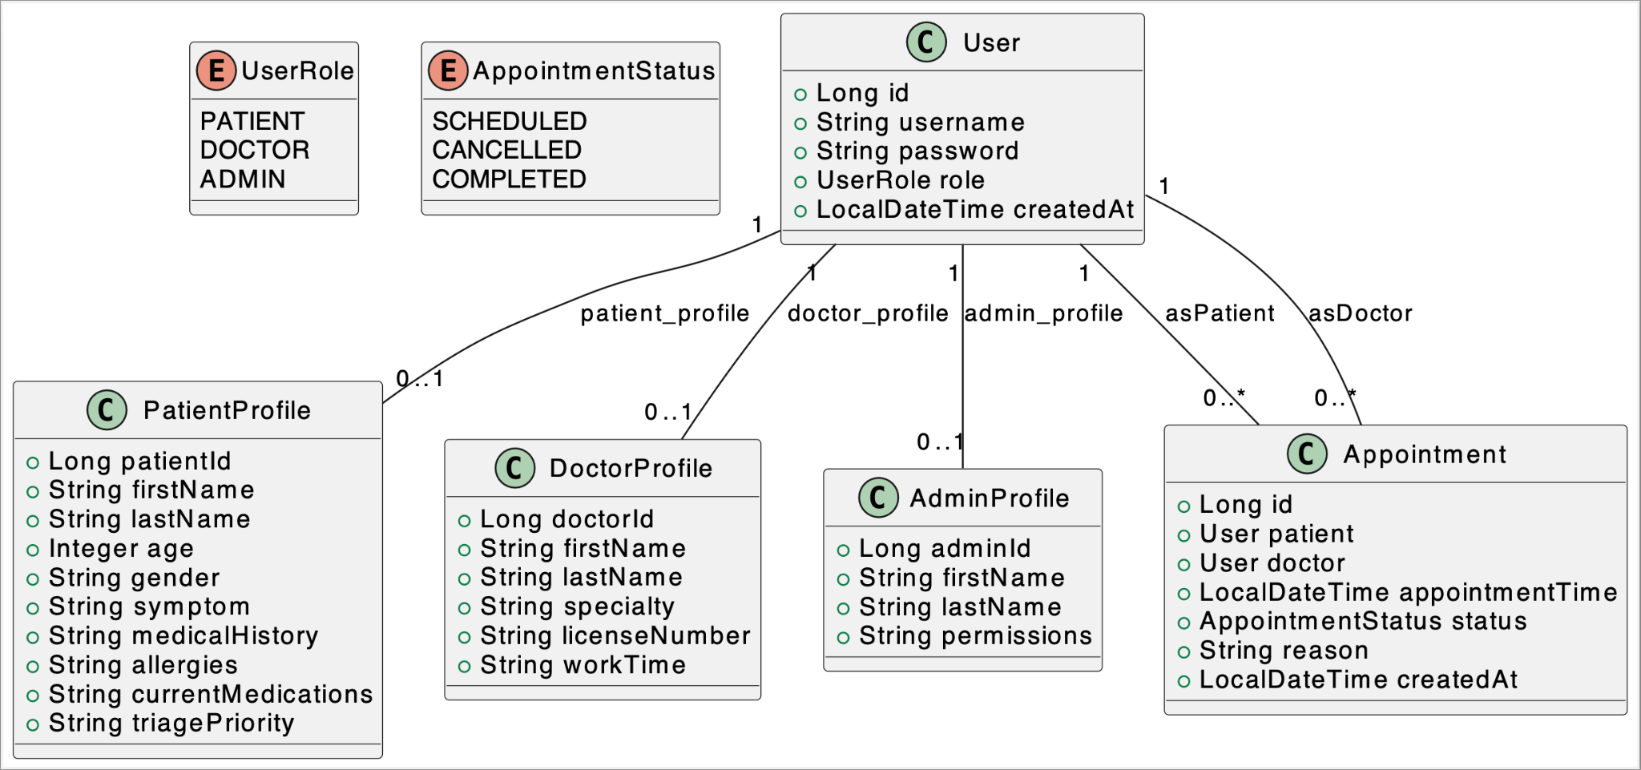
Entity UML Diagram

Slide 8
C
Lessons Learned
Architecture – Controller, Service, Repository
Single responsibility - Entity separation
  Users
    patient_profile, doctor_profile, admin_profile
  Appointments
Dependency Inversion Principle
  Service implementation

Slide 9
Y
Goals in the future
Integrate AI agent for symptom pre-screening, chatbot support, and initial triage recommendations.
Add Redis caching to speed up frequent queries such as doctor availability and appointment history.
Support third-party authentication (OAuth 2.0 / token-based login) for more secure and scalable user access.

Slide 10
Y
Citations
https://spring.io/projects
https://swagger.io/tools/swagger-ui/
https://docs.docker.com/guides/
https://wiki.postgresql.org/wiki/Developer_FAQ#How_do_I_get_involved_in_PostgreSQL_development.3F

Slide 11




Thank you
&
Merry
Christmas!

